Slide 1
Notes to the Presenter
Slides 2-10 contain notes for the presenter and are hidden.
You may include your picture and company logo on the intro slide only
It is appropriate to provide a brief background (1 minute or less) on your organization.

Slide 2
Presentation Best Practices
Frame your presentation by answering:
What do you want your audience to learn?
What do you want your audience to do differently?
What result or outcomes do you want your audience to realize?
Clarify your session objectives at the beginning of your presentation.

Slide 3
Presentation Best Practices
Pictures speak 1,000 words; include a screenshot or picture on each slide to add visual interest.
A good goal is to aim for 7 words per slide.
Increase attention and interaction by using a variety of communication mediums, such as polls and videos.
Plan and follow a rough agenda including a breakdown by minute to help stay on track.

Slide 4
Example of Text Layout
Main topic 1: size 28pt
Size 24pt for the subtopics
Size 24pt for the subtopics
Main topic 2: size 28pt
Size 24pt for the subtopics
Size 24pt for the subtopics
Main topic 3: size 28pt
Size 24pt for the subtopics
Size 24pt for the subtopics

Slide 5
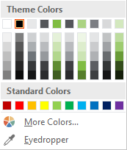
Slide Palette Info
The PowerPoint palette for this template has been built for you and is shown below. Avoid using too many colors in your presentation.
Select the 4th color from the left for subheads and 1st level non-bulleted text color, or wherever “color” text is preferred over the default black/white text
Accent colors 1-6 – (6 Theme Colors to the far right)
Text
Dark 2
Accent 1
Accent 2
Accent 3
Accent 4
Accent 5
Accent 6
Use Accent 1 as the main accent color. Use Accent 2 and Accent 3 when additional colors are needed.
Use Accents 4-6 sparingly – only when more colors are necessary.

Slide 6
Chart Example

Slide 7
Lots of data? Minimalize and Plan
Gray is used to de-emphasize data that is less important. Use cool gray 3 or cool gray 7. See slide 7 for color formulas.
All elements have the same interior margins as text blocks.
When a chart or graphic, has more elements than can easily be aligned to the grid, align the outer edges of the group, top, bottom, left and right edges to the grid.
It is preferable to keep the group aligned to the left border.
130M
140M
125M
Other
Other
Other
Other
Other
Other

Slide 8
Chart Example

Slide 9
Notes (hidden)
Some speakers like to use this slide for hidden “notes slides”.
Delete it if you don’t want to use it.

Slide 10
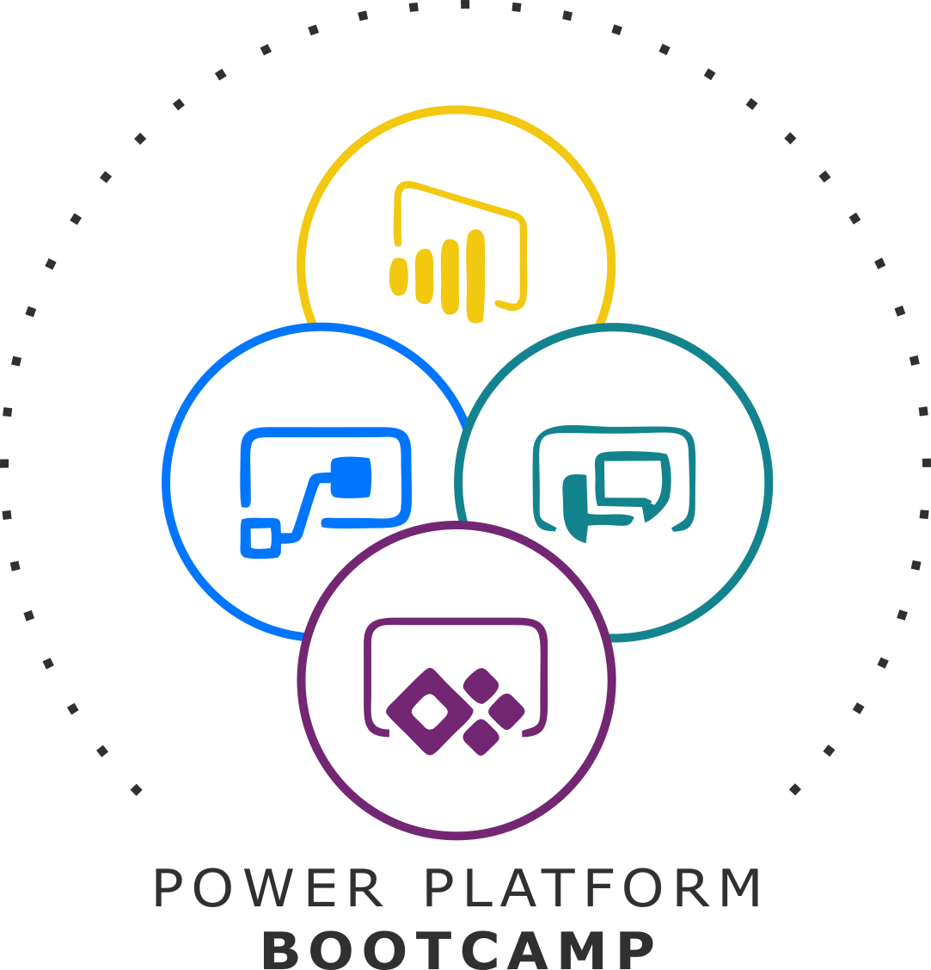


GLOBAL POWER PLATFORM BOOTCAMP
Organized Globally, Held Locally

Slide 11
Using Power Apps component framework to build reusable custom user experiences
Dhawal Seth #PowerAddict

Slide 12
Using Power Apps component framework
Dhawal Seth

Slide 13

Dhawal Seth
Architect #PowerAddict
@dhawallseth
Wipro
Gurgaon Power User Group Leader

Slide 14
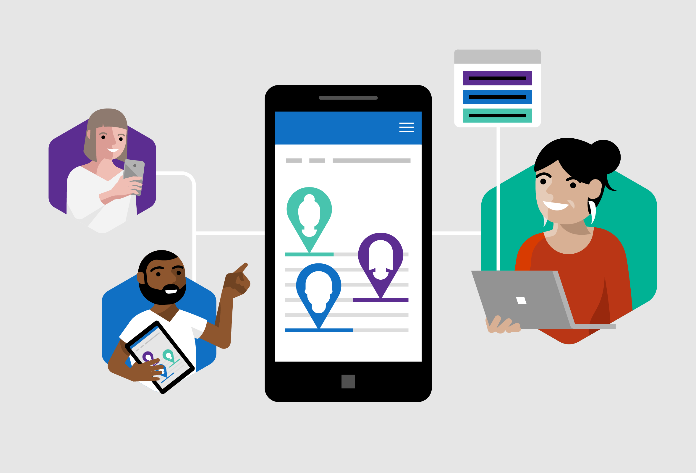
Empower every developer to do more.
Power Apps Mission
Citizen Developers.
IT Developers.
Pro Developers.

Slide 15
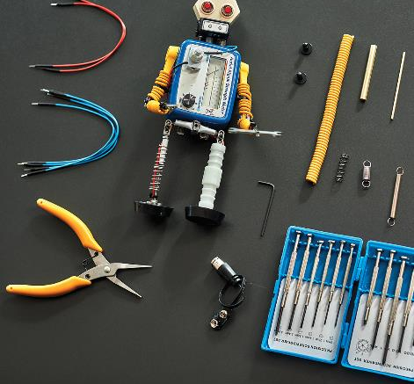
Agenda
Framework introduction
Customer demo
Building a custom component
Release timelines
QnA

Slide 16

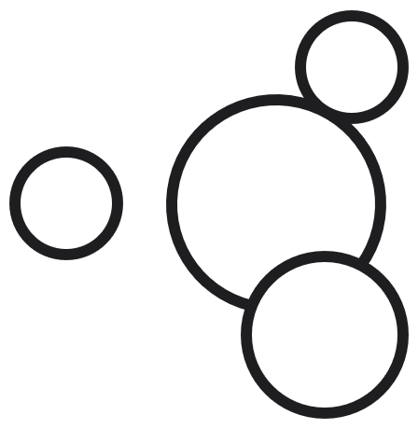

Microsoft Power Platform
The low-code platform that spans Office 365, Azure, Dynamics 365, and standalone applications
Power BI
Business analytics
Power Apps
Application development
Power Automate
Process automation
Power Virtual Agents
Intelligent virtual agents
Data connectors
Common Data Service
AI Builder

Slide 17



Develop faster than ever before
Azure + Power Apps = No Limits
Every Developer
Power Platform
Power Apps
Power Apps component framework
Azure
DevOps
Azure services
API management
Azure Functions
AKS
Cognitive Services
Pro Developer
Azure Data Services
Cosmos DB
SQL Azure
SQL Data Warehouse
Visual
Studio
VS
Code

Slide 18
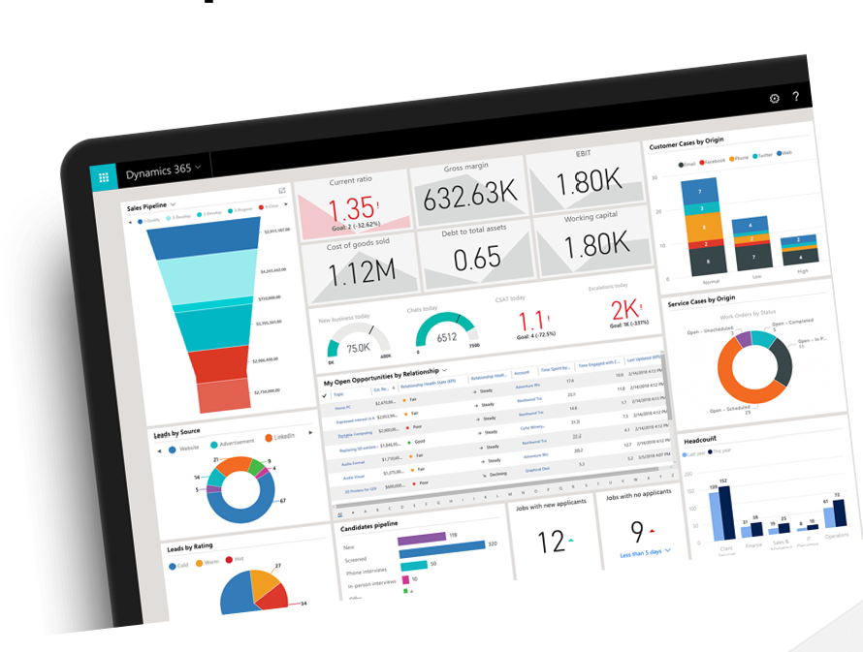
What is Power Apps component framework

Slide 19
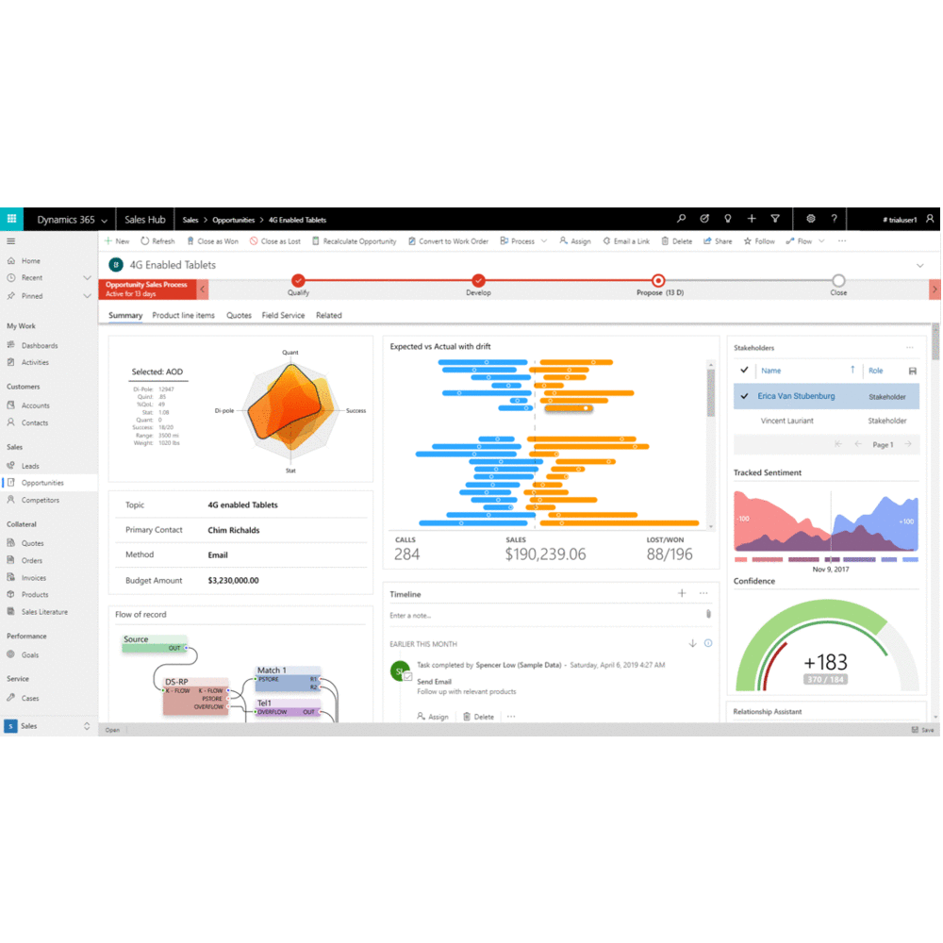
Power Apps component framework
One unified framework for building custom UI components
Supports model-driven and canvas apps
Available for 1st and 3rd party developers.
Professionally developed controls with well defined contracts, lifecycle and interaction model
Improves performance, reliability and diagnostics
Modern developer tooling, including CLI, build and debug tools

Slide 20
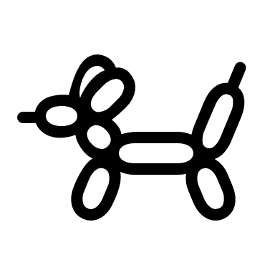


Convergence from multiple app types…
Canvas Apps
Model Driven Apps
App
App
App
View
Dashboard
Screen
Form
Screen
> > > BPF > > >
Canvas Component
Pro Developer Component (PCF)
Connectors
Expressions
Connectors
Expressions
Connectors
Expressions
Business Rules
Canvas controls
Unified Interface

Slide 21






… to rich component ecosystem
Apps built entirely on Power Apps Dynamics 365 apps, standalone ISV apps
Apps customized with embedded components SharePoint, Teams, Power BI, ISV apps
Pages composed from one or more component type
A rich ecosystem of components
Canvas Components
Modeled Components
AI Builder Components
Flow Components
1st Party Components
Pro Components (PCF)
3rd Party (AppSource)
Unified controls (PCF)
Unified CDS + connector capabilities

Slide 22
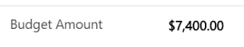
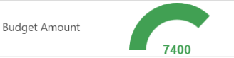
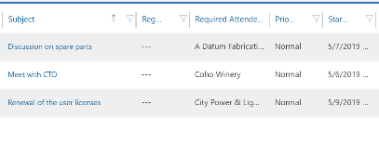
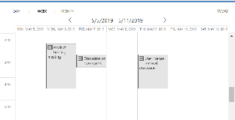
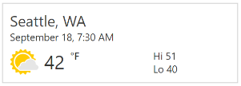
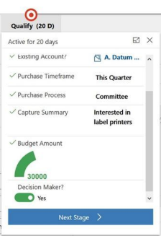
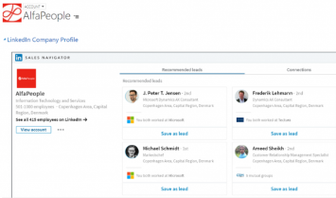
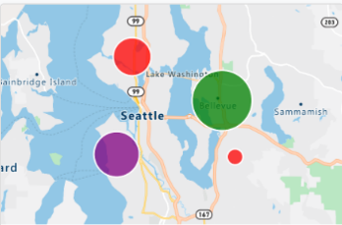
What type of components can I add ?
Field control on the form
Entity grid\sub grid
Unbound controls
Business Process step
Display external content
Utilize external services

Slide 23
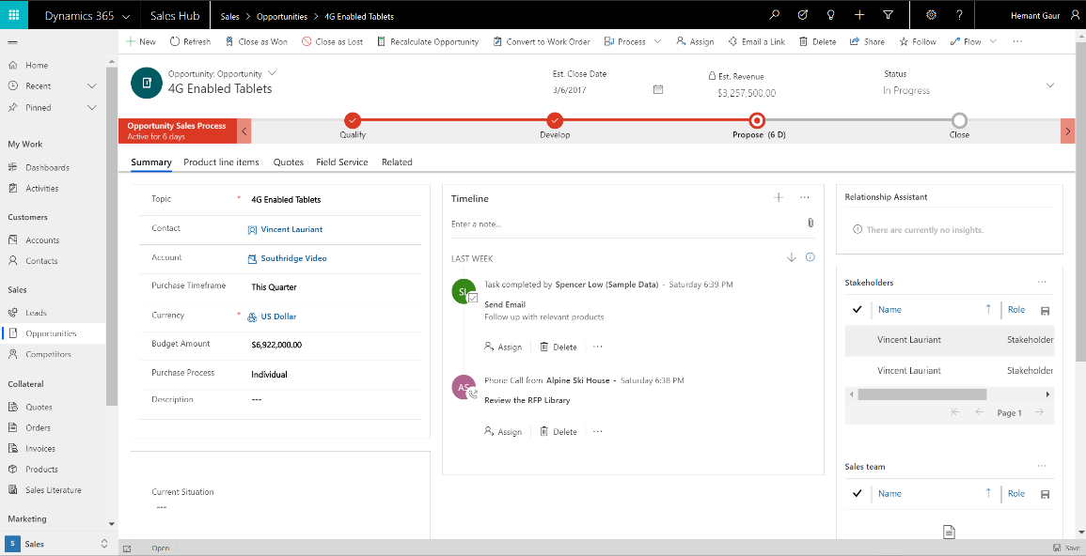
Before

Slide 24
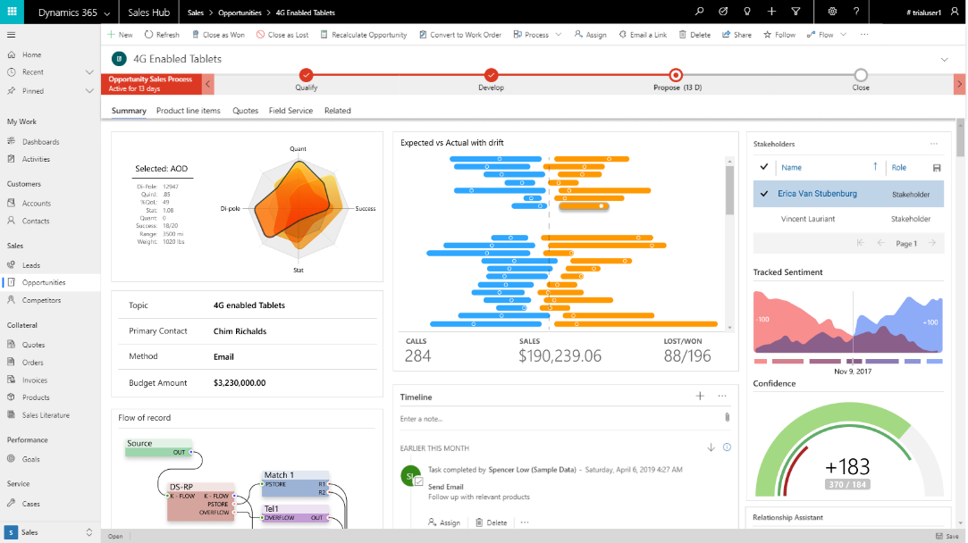
After

Slide 25
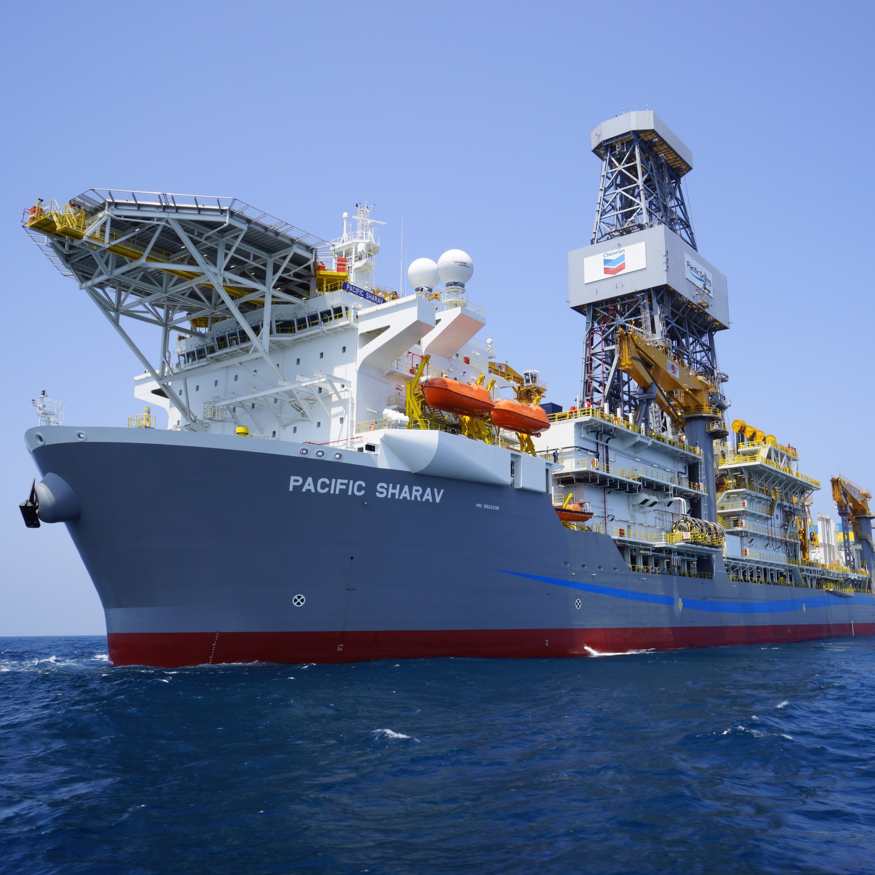
Digitally Enhanced Well Planning Tool
Russell Robinson
Drilling Engineer & Digital Team Lead - Chevron

Slide 26
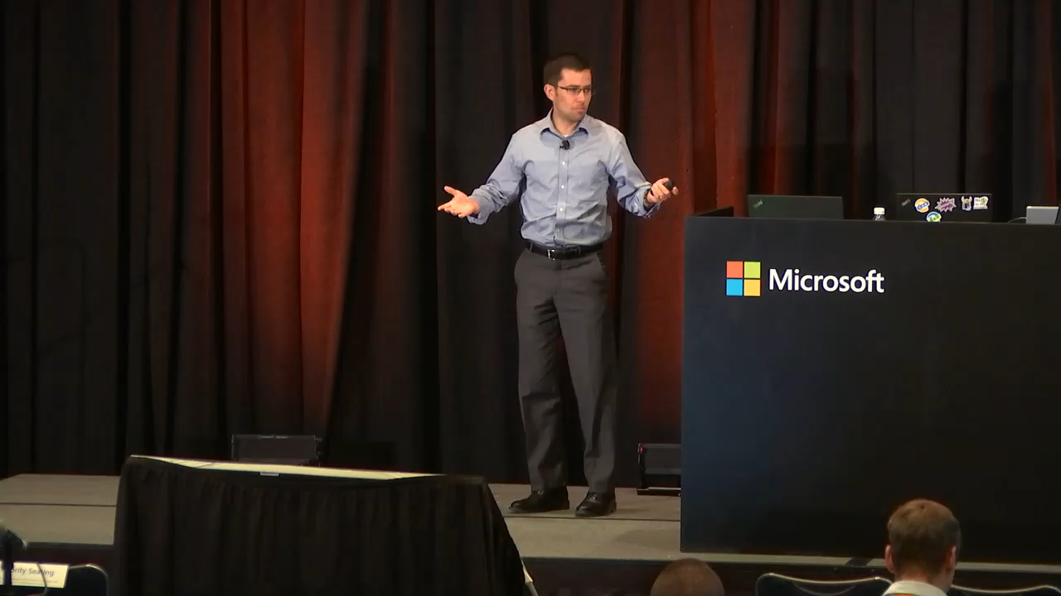

Slide 27
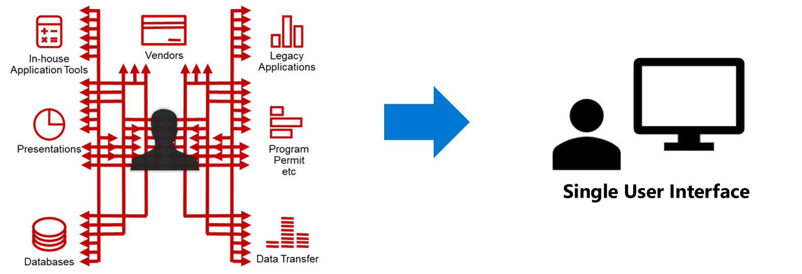
Engineering Workflow Focus on what we need to do rather than how we currently do it

Slide 28
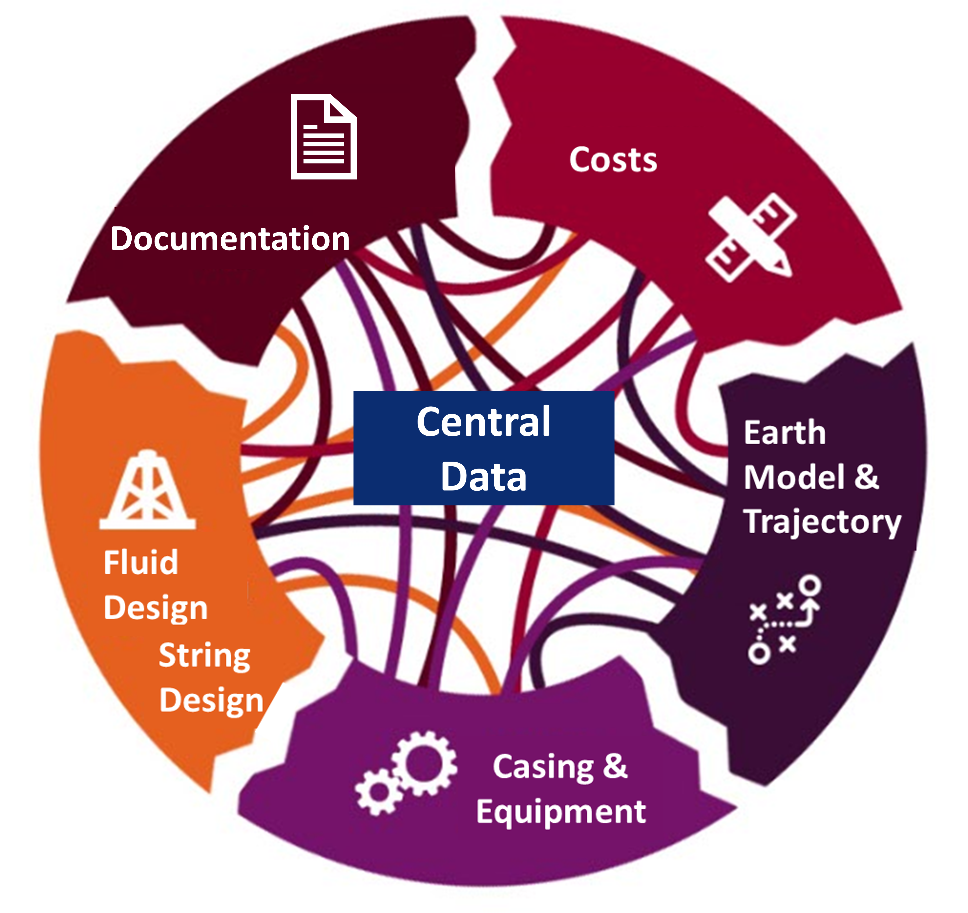
A digital tool that integrates and streamlines the well planning process

Slide 29
Custom Components Drivers behind using custom components in the well planning tool
User Challenges
Developer Challenges
“Blackbox” engineering calculations
Complex data relationships
Navigation difficulties and usability
Number of fields
Lifecycle sustainability and support

Slide 30
Building a custom component

Slide 31
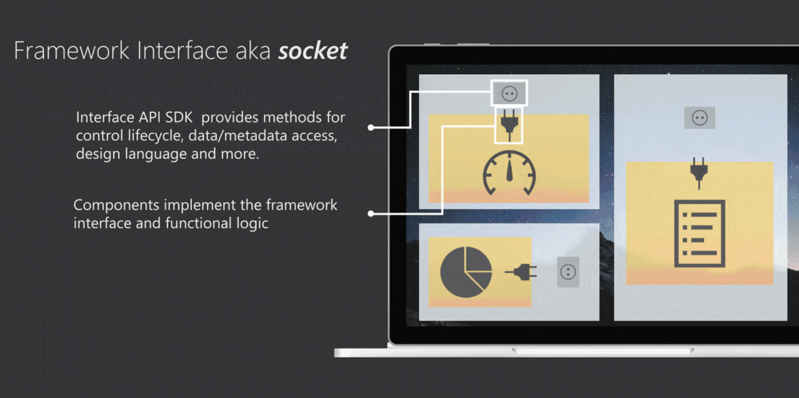

Slide 32

What makes a custom component?
Manifest Input File
Component Implementation
Code
Resource Files
Static Resources
Control definition
Name
TypeScript or JavaScript
CSS
Localization
Properties
Resource files
Functionality
Images, etc.
Version
User Interface

Slide 33
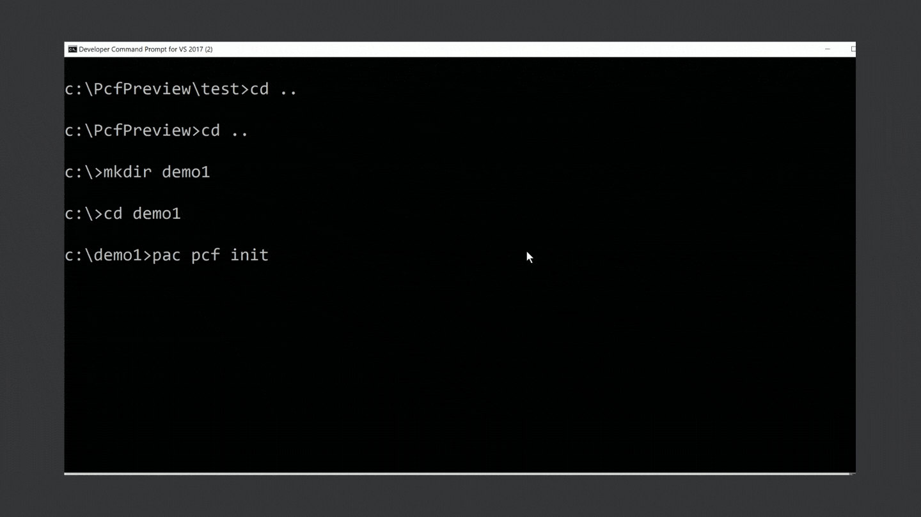
Developer tooling - Power Apps CLI
Simple to use command line interface (CLI) with control templates (field and dataset) support
Built in validations to catch issues prior to deployment
Can be used headless as part of automated build processes
Local debug harness to render and test the control locally
Support for solution packaging
Power Apps CLI will evolve to support other component types like Plugins and Web resources

Slide 34
Demo

Slide 35

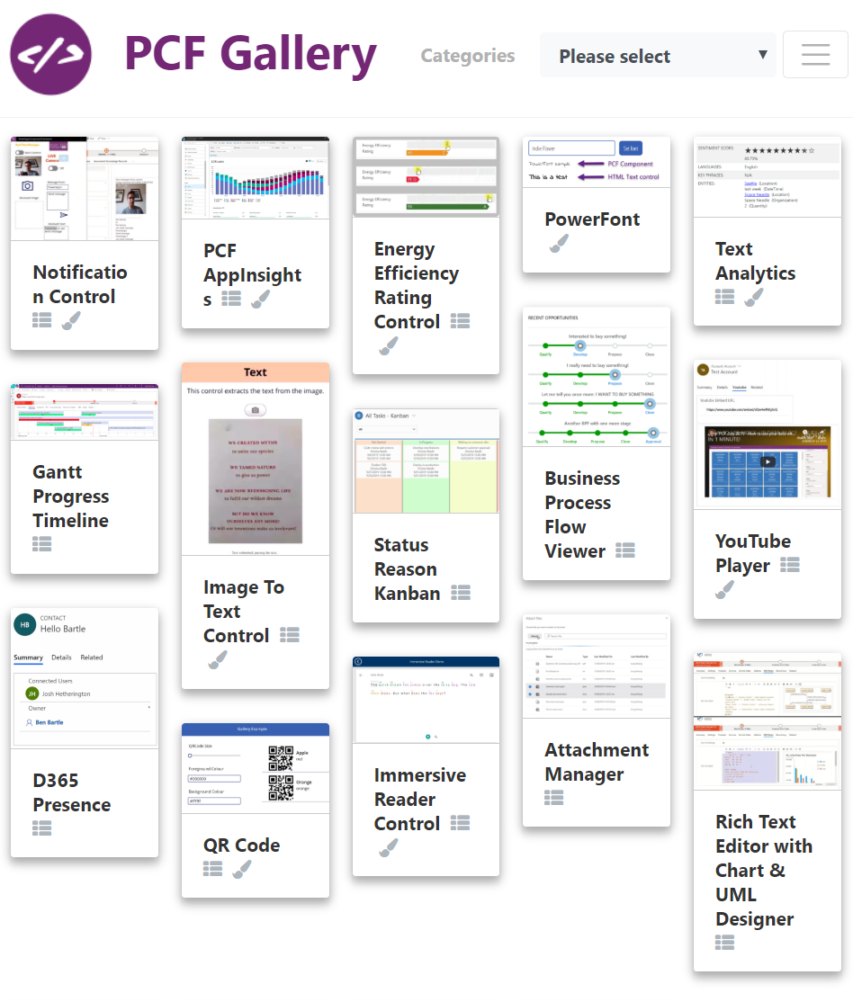


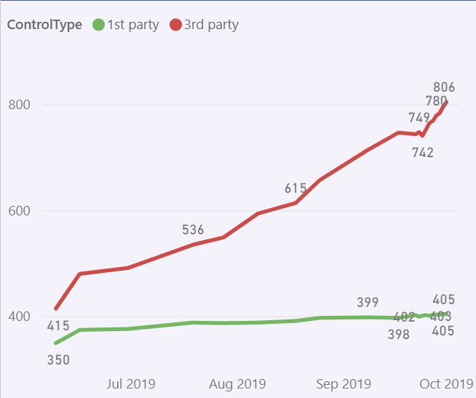

Framework Release status and adoption
PCF Model-driven apps
Public preview April 2019
PCF Canvas apps
GA Early 2020
PCF Model-driven apps
GA Oct 2019
PCF Canvas apps
Experimental preview Sep 2019
PCF Canvas apps
Public Preview Nov 2019
54k
10.5k
3rd party MAU
Organizations with
3rd party control
1000+ 3rd party controls
100+ open sourced controls - https://pcf.gallery
(non-msft site by Guido Preite MVP)

Slide 36
References
Getting started https://aka.ms/PCFBlog
https://aka.ms/PCFCanvasBlog
Documentation https://aka.ms/PCFDocs
Community Forum https://aka.ms/PCFForum
Feature Ideas https://aka.ms/PCFIdea
Community components https://aka.ms/PCFDemos

Slide 37
Any Questions?

Slide 38

Please fill out the survey! & Win Swags!!
https://www.powerplatformbootcamp.com/survey

Slide 39
Thank You For Attending

